Slide 1

“Bridging the virtual trio : Health, Work, and Life.”
Prototype Phase Submission
Connecting Health, Work and Life …

Slide 2
Team Name : Pradeep Kumar Shah Team Mates: Member 1 : Pradeep Kumar Shah Theme : “Bridging the virtual trio - Health, Work, and Life.”

Slide 3
OVERVIEW: “Wellbeing exists in two dimensions, subjective and objective. It comprises an individual’s experience of their life as well as a comparison of life circumstances with social norms and values”.

Slide 4
OBJECTIVE: It can provide a shared objective around which to engage to deliver health benefits. For example, promoting physical activity has benefits for health but it also has a benefit for wellbeing. In addition, strengthening social networks and time spent socialising benefit wellbeing as well as improving mental health in particular.

Slide 5
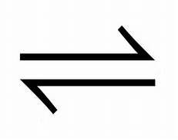
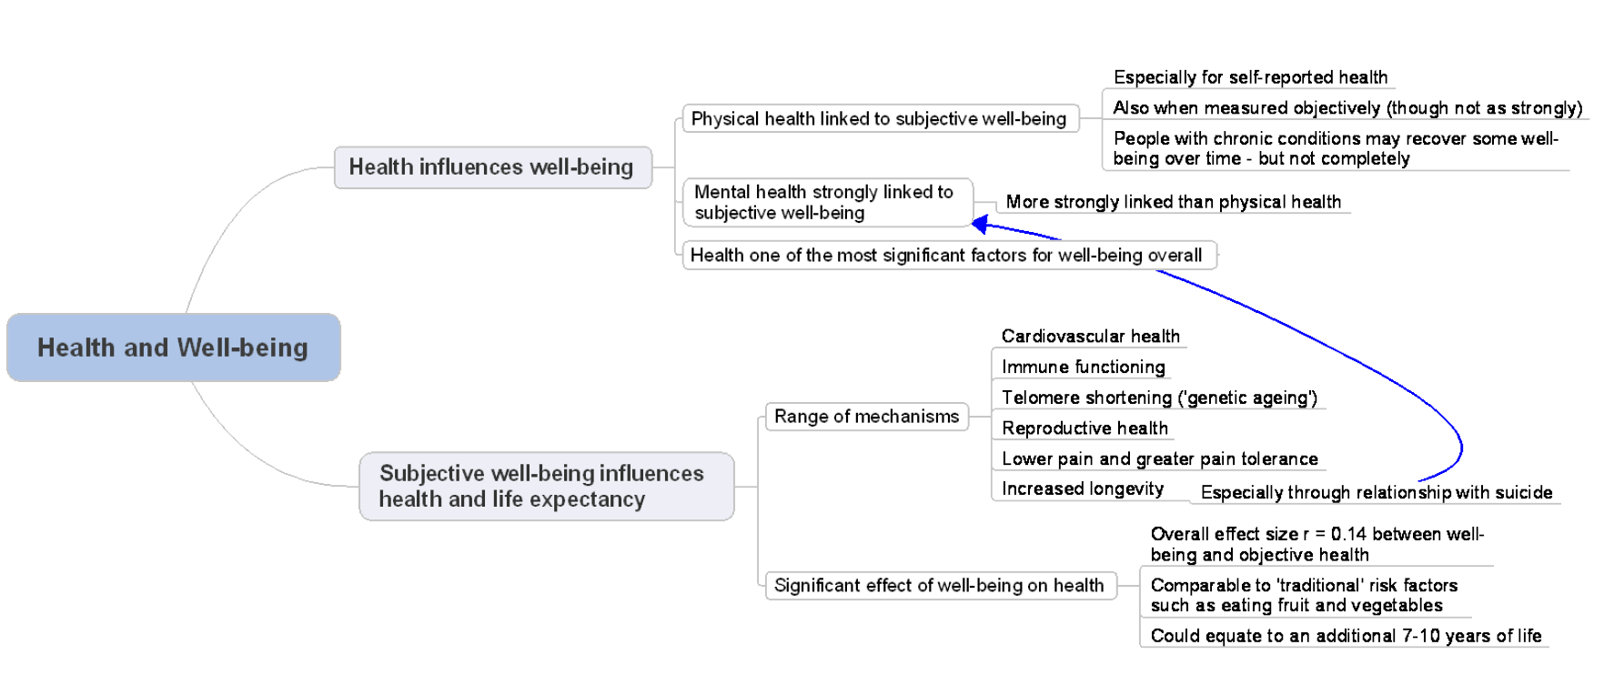
Process : Health WORK LIFE

Slide 6

THANK YOU …

